Slide 1

A Festive PhD Lecture Eylon Yogev

Slide 2
Search Problems: A Cryptographic Perspective

Slide 3
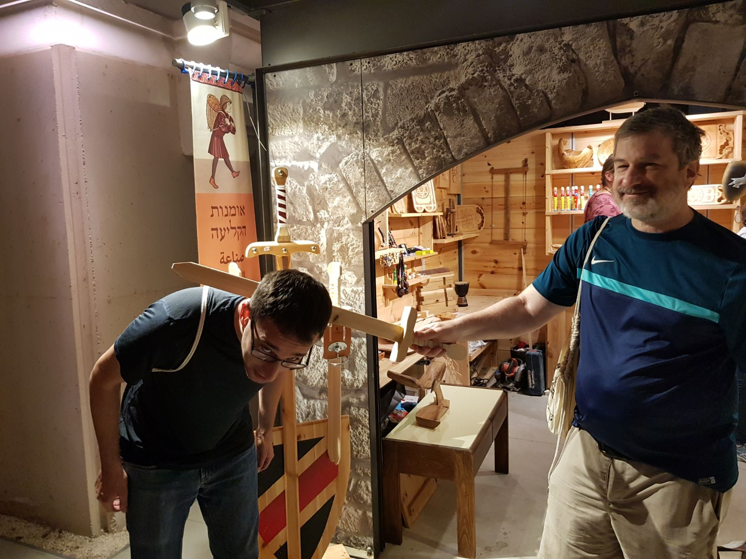
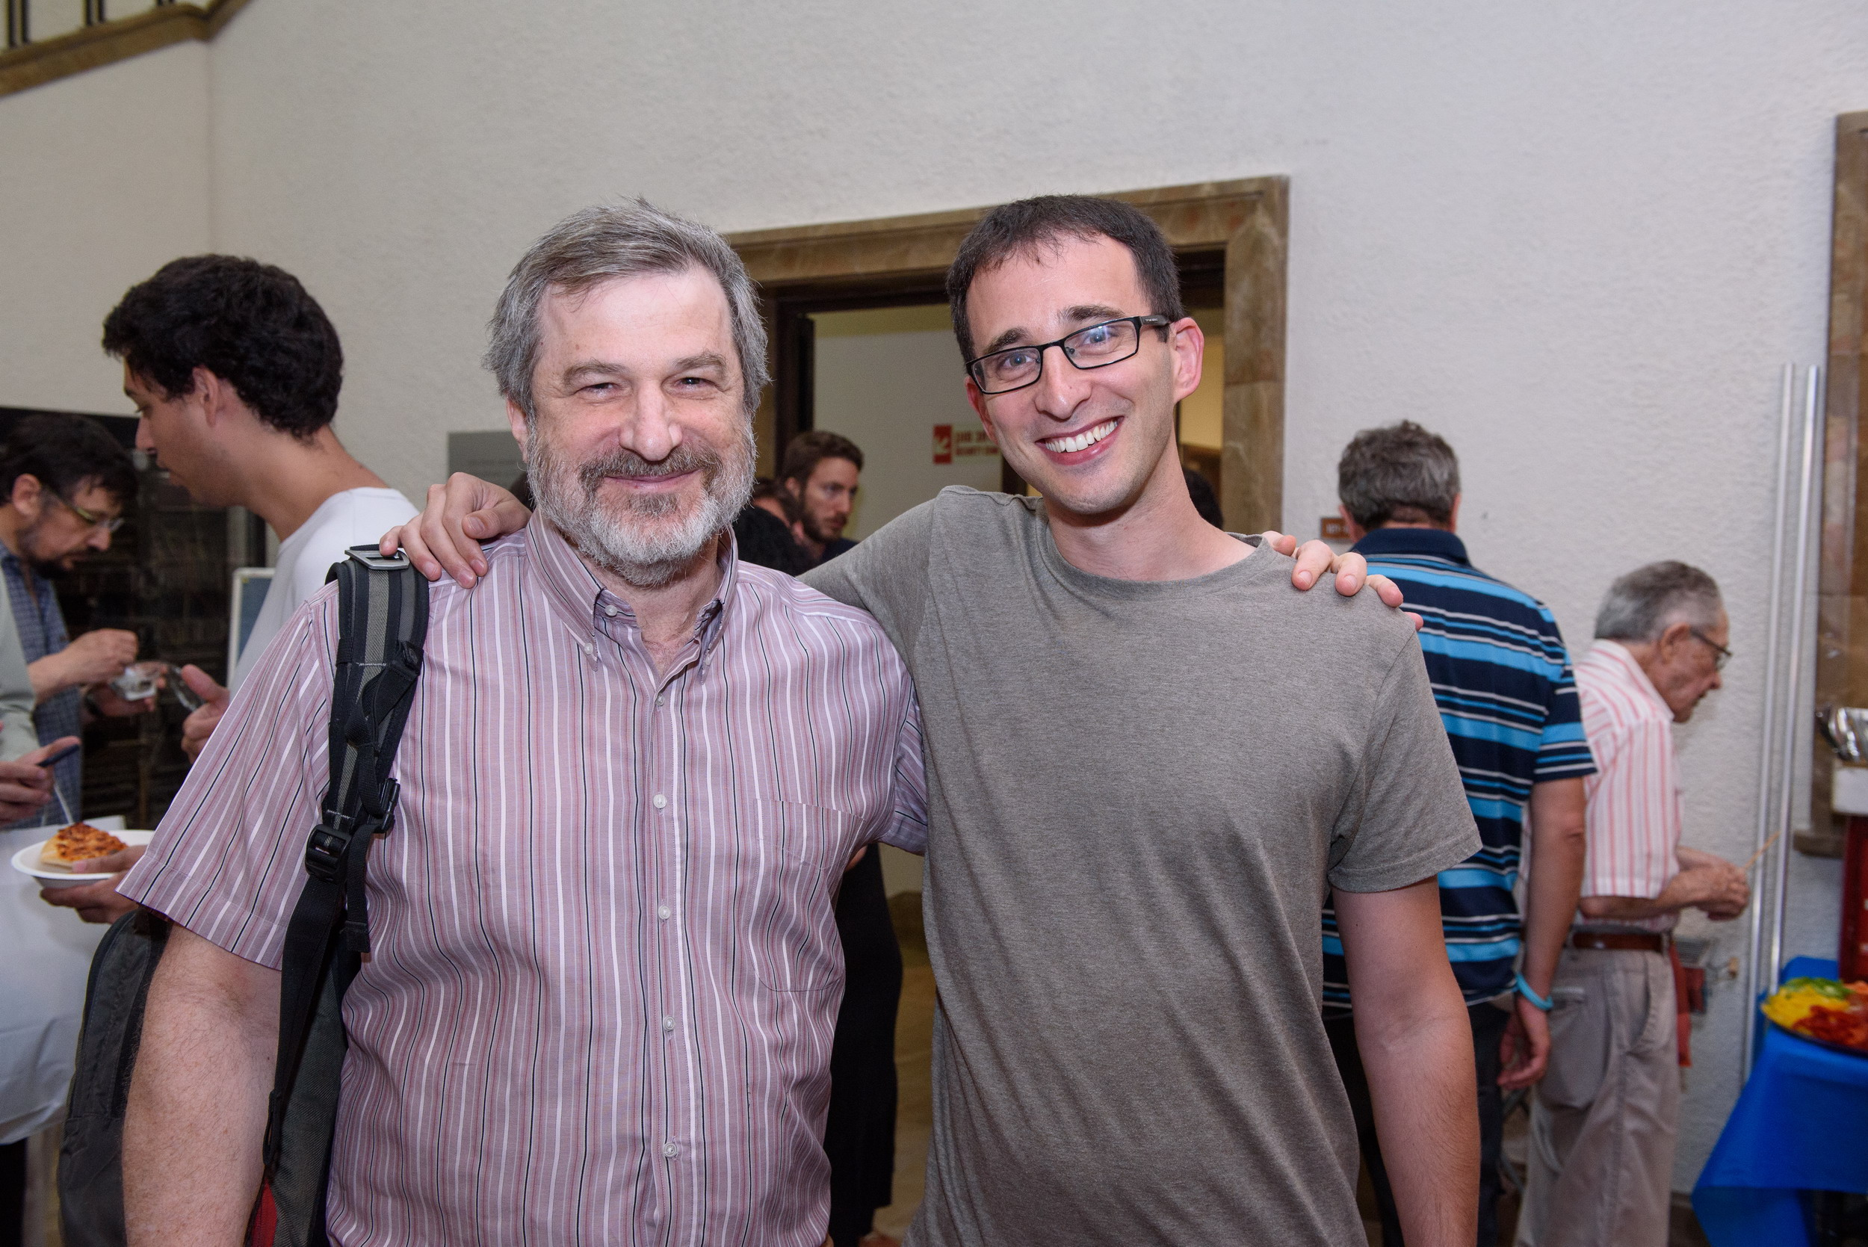
Moni

Slide 4
Computer Science: A Cryptographic Perspective

Slide 5
Obfuscation, NP Secret-Sharing:
[Komargodski-Moran-Naor-Pass-Rosen-Y14], [Komargodski-Naor-Y15], [Komargodski-Naor-Y16]
Computational Complexity
Adversarial Bloom Filters: [NaorY13], [NaorY15]
Cryptography
Search Problems
Cryptography
Data Structures
Distributed Algorithms
Ramsey, Local Search, Hashing:
[Hubacek-Naor-Y17], [Hubacek-Y17], [Komargodski-Naor-Y17], [Komargodski-Naor-Y18]
Secure Distributed Algorithm & Derandomization:
[Halevi-Ishai-Jain-Komargodski-Sahai-Y17], [Parter-Y17], [Parter-Y18a], [Parter-Y18b]

Slide 6
I rarely end up where I was intending to go, but often I end up somewhere I needed to be.
Douglas Adams

Slide 7
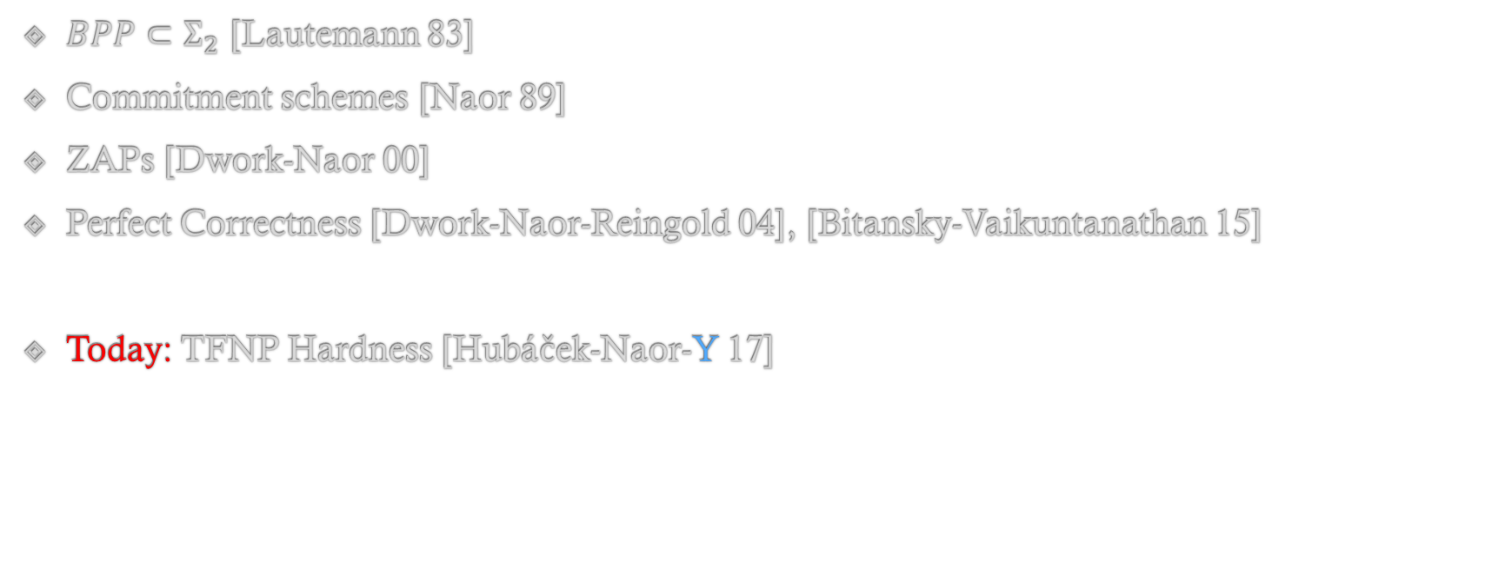
Reverse Randomization
$BPP⊂Σ_{2}$ [Lautemann 83]
Commitment schemes [Naor 89]
ZAPs [Dwork-Naor 00]
Perfect Correctness [Dwork-Naor-Reingold 04], [Bitansky-Vaikuntanathan 15]
Today: TFNP Hardness [Hubáček-Naor-Y 17]

Slide 8
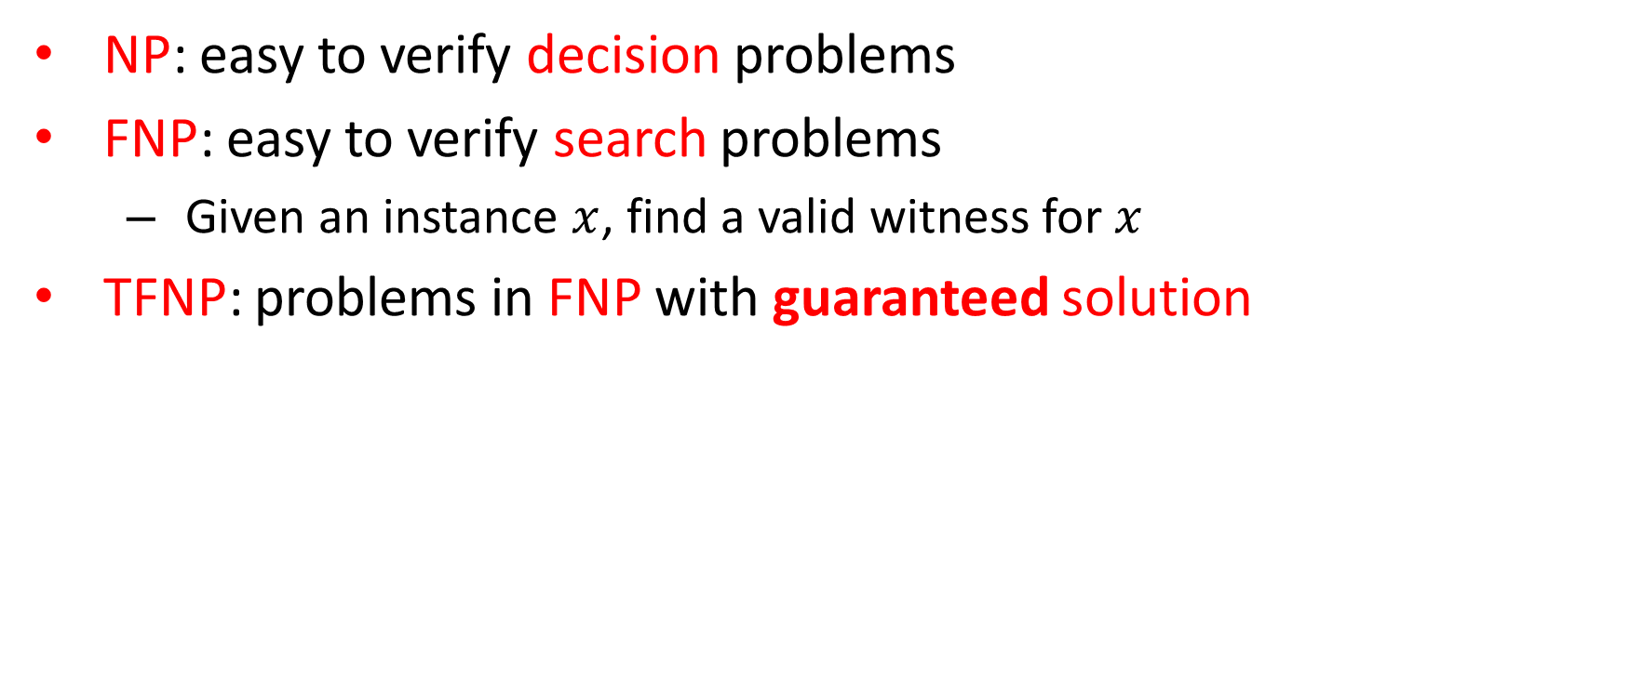
TFNP – Total Function NP [MP91]
NP: easy to verify decision problems
FNP: easy to verify search problems
Given an instance $x$, find a valid witness for $x$
TFNP: problems in FNP with guaranteed solution
Megiddo- Papadimitriou
FNP
coNP
NP
TFNP
P
FP
Notes:
Try to prune the text, be more succinct e.g.,
NP: easy to verify decision problems
FNP: easy to verify search problems
TFNP: search problems in FNP with guaranteed solution

Slide 9





TFNP Landscape
Polynomial Pigeonhole Principle
“Every length preserving function either has a collision or a preimage for 0”
$$TFNP$$
$$PPP$$
Local Optimum
“Every DAG has a sink”
$$PLS$$
$$PPAD$$
Nash Equilibrium
Brouwer Fixed Points
“every directed graph with an unbalanced node must have another”
Continuous Local Optimum [DP11]
“Every function has a local optimum”
$$CLS$$

Slide 10

Hardness
Collision resistant hash / one-way permutation
[Pap94]
$$TFNP$$
$$PPP$$
$$PLS$$
P $≠$ NP ?
$$PPAD$$
Ramsey [KNY17]
?
$$CLS$$
Obfuscation/FE
[HY17]
Obfuscation/FE
[BPR15]

Slide 11
WHAT IS THE WEAKEST ASSUMPTION UNDER WHICH WE CAN SHOW HARDNESS OF TFNP?

Slide 12



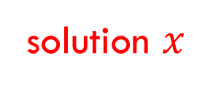

Hardness based on P $≠$NP
formula $φ$
$$SAT$$
$$TFNP$$
solution $x$
$$⇒NP=coNP$$

Slide 13
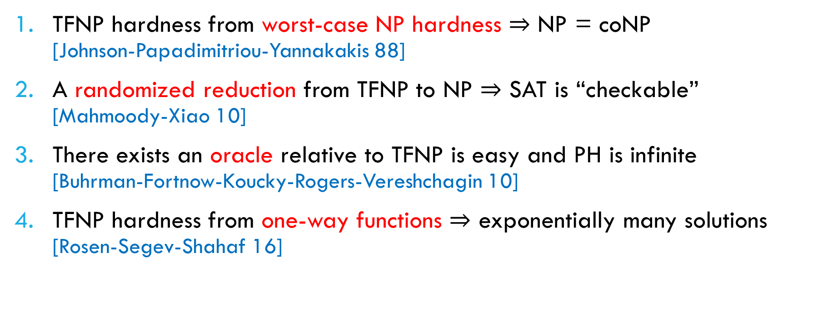
Barriers for Proving TFNP Hardness
TFNP hardness from worst-case NP hardness $⇒$ NP = coNP [Johnson-Papadimitriou-Yannakakis 88]
A randomized reduction from TFNP to NP $⇒$ SAT is “checkable” [Mahmoody-Xiao 10]
There exists an oracle relative to TFNP is easy and PH is infinite [Buhrman-Fortnow-Koucky-Rogers-Vereshchagin 10]
TFNP hardness from one-way functions $⇒$ exponentially many solutions [Rosen-Segev-Shahaf 16]
Notes:
Maybe decrease the font size a bit and try to make the each item fit a single line.

Slide 14

The Five Worlds of Impagliazzo
Algorithmica: P = NP
Heuristica: P $≠$ NP but NP is easy-on-average
Heuristica: P ≠ NP but NP is easy-on-average
Pessiland: NP is hard-on-average but $∄$ one-way functions
Pessiland: NP is hard-on-average but ∄ one-way functions
Minicrypt: $∃$ one-way functions but $∄$ public-key crypto
Minicrypt: ∃ one-way functions but ∄ public-key crypto
Cryptomania: $∃$ public-key cryptography
Cryptomania: ∃ public-key cryptography
Obfustopia: $∃$ indistinguishability obfuscation
Notes:
This is a nice slide

Slide 15
The Five Worlds of Impagliazzo
Algorithmica: P = NP
Heuristica: P $≠$ NP but NP is easy-on-average
Heuristica: P ≠ NP but NP is easy-on-average
Pessiland: NP is hard-on-average but $∄$ one-way functions
Pessiland: NP is hard-on-average but ∄ one-way functions
Minicrypt: $∃$ one-way functions but $∄$ public-key crypto
Minicrypt: ∃ one-way functions but ∄ public-key crypto
Cryptomania: $∃$ public-key cryptography
Cryptomania: ∃ public-key cryptography
Obfustopia: $∃$ indistinguishability obfuscation

Slide 16
The Five Worlds of Impagliazzo
Algorithmica: P = NP
Heuristica: P $≠$ NP but NP is easy-on-average
Heuristica: P ≠ NP but NP is easy-on-average
Pessiland: NP is hard-on-average but $∄$ one-way functions
Pessiland: NP is hard-on-average but ∄ one-way functions
Minicrypt: $∃$ one-way functions but $∄$ public-key crypto
Minicrypt: ∃ one-way functions but ∄ public-key crypto
Cryptomania: $∃$ public-key cryptography
Cryptomania: ∃ public-key cryptography
Obfustopia: $∃$ indistinguishability obfuscation

Slide 17
Our Results
TFNP* hardness can be based on any hard-on-average language in NP
For example: planted clique, random SAT, etc.
In particular, any one-way function.
Our results show: hard-on-average TFNP problems exist in Pessiland (and beyond)
* In the non-uniform setting (will elaborate later).
Notes:
No need for case: planted clique, random SAT

Slide 18
The Five Worlds of Impagliazzo
Algorithmica: P = NP
Heuristica: P $≠$ NP but NP is easy-on-average
Heuristica: P ≠ NP but NP is easy-on-average
Pessiland: NP is hard-on-average but $∄$ one-way functions
Pessiland: NP is hard-on-average but ∄ one-way functions
Minicrypt: $∃$ one-way functions but $∄$ public-key crypto
Minicrypt: ∃ one-way functions but ∄ public-key crypto
Cryptomania: $∃$ public-key cryptography
Cryptomania: ∃ public-key cryptography
Obfustopia: $∃$ indistinguishability obfuscation

Slide 19
The Five Worlds of Impagliazzo
Algorithmica: P = NP
Heuristica: P $≠$ NP but NP is easy-on-average
Heuristica: P ≠ NP but NP is easy-on-average
Pessiland: NP is hard-on-average but $∄$ one-way functions
Pessiland: NP is hard-on-average but ∄ one-way functions
Minicrypt: $∃$ one-way functions but $∄$ public-key crypto
Minicrypt: ∃ one-way functions but ∄ public-key crypto
Cryptomania: $∃$ public-key cryptography
Cryptomania: ∃ public-key cryptography
TFNP Hardness
Obfustopia: $∃$ indistinguishability obfuscation

Slide 20
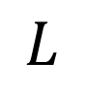
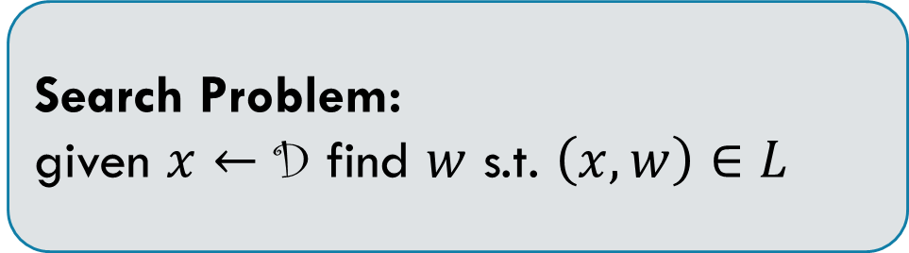

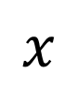
Proof
Let $L∈NP$ be a hard-on-average language with distribution D
{0,1}^{n}
D
Not in TFNP
$$L$$
Search Problem: given $x←$ D find $w$ s.t. $\left(x,w\right)∈L$
$$x$$

Slide 21
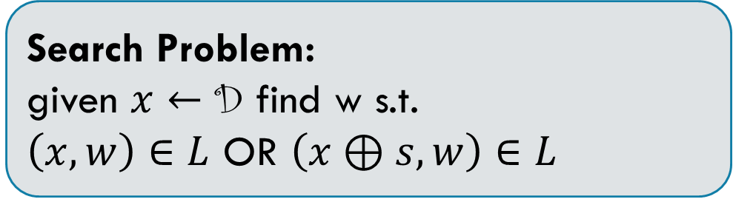
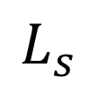
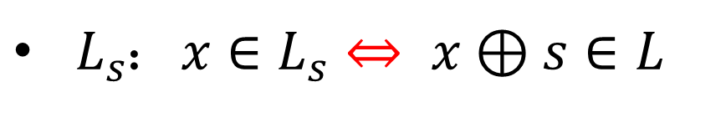
Reverse Randomization
$L_{s}$: $x∈L_{s}⇔ x⊕s∈L$
{0,1}^{n}
D
$$L_{s}$$
Distributed according to D
Random shift of D
Not a hard distribution
$$L$$
Search Problem: given $x←$ D find w s.t.
$\left(x,w\right)∈L$ OR $\left(x⊕s,w\right)∈L$
$$x$$

Slide 22
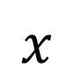
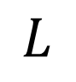
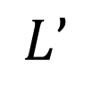
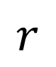
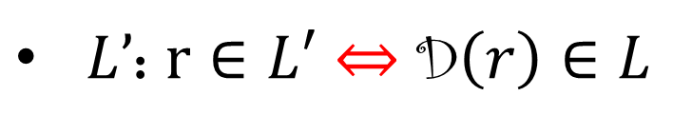
Proof
$L’$: $r∈L′$ $⇔$ D$\left(r\right)∈L$
{0,1}^{m}
D
{0,1}^{n}
$$L’$$
$$L$$
$$r$$
$$x$$

Slide 23
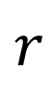
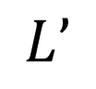
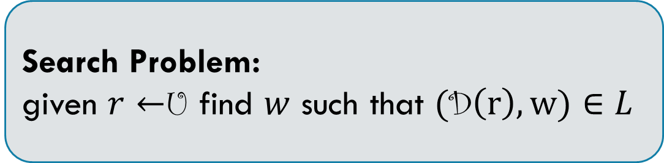
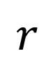
Proof
$L’$: $r∈L′$ $⇔$ D$\left(r\right)∈L$
{0,1}^{m}
U
$$r$$
Search Problem: given $r←$U find $w$ such that $($D$\left(r\right),w)∈L$
$$L’$$
$$r$$
Notes:
The same as for curly D and normal D goes also for curly U and normal U.

Slide 24
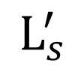
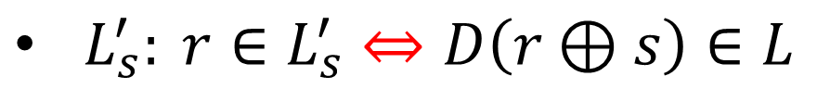
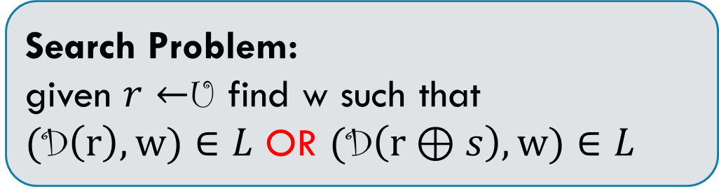
Proof
$L_{s}^{′}: r∈L_{s}^{′}⇔D\left(r⊕s\right)∈L$
{0,1}^{m}
U
$$r$$
Search Problem: given $r←$U find w such that
$($D$\left(r\right),w)∈L$ OR $($D$\left(r⊕s\right),w)∈L$
$$L’$$
$$r$$
$$L_{s}^{′}$$
Notes:
Typo: L’_i in the bullet point

Slide 25
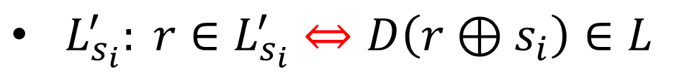
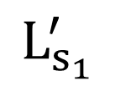

proof
$L_{s_{i}}^{′}: r∈L_{s_{i}}^{′}⇔D\left(r⊕s_{i}\right)∈L$
{0,1}^{m}
U
$$r$$
Search Problem: given $r←$U find w such that $($D$\left(r⊕s_{i}\right),w)∈L$ for some i
$$L’$$
$$r$$
$$L_{s_{1}}^{′}$$
Notes:
Typos: L’_i in the bullet point and L’_{s_1} in the picture

Slide 26
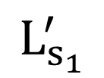
proof
$L_{s_{i}}^{′}: r∈L_{s_{i}}^{′}⇔D\left(r⊕s_{i}\right)∈L$
{0,1}^{m}
U
r
Search Problem: given $r←$U find w such that $($D$\left(r⊕s_{i}\right),w)∈L$ for some i
L’
r
$$L_{s_{1}}^{′}$$
Hard distribution?

Slide 27
Is this a Hard Distribution?
The instance is the random coins of the distribution
Can we learn anything from the random coins about the solution?
Think of the planted clique vs. random SAT
We need the distribution to be a “public-coin” distribution
Do such distributions necessarily exist?
Theorem: There exists a reduction from private-coin to public-coin
[Impagliazzo-Levin 90]
Proof goes through universal one-way hash function

Slide 28
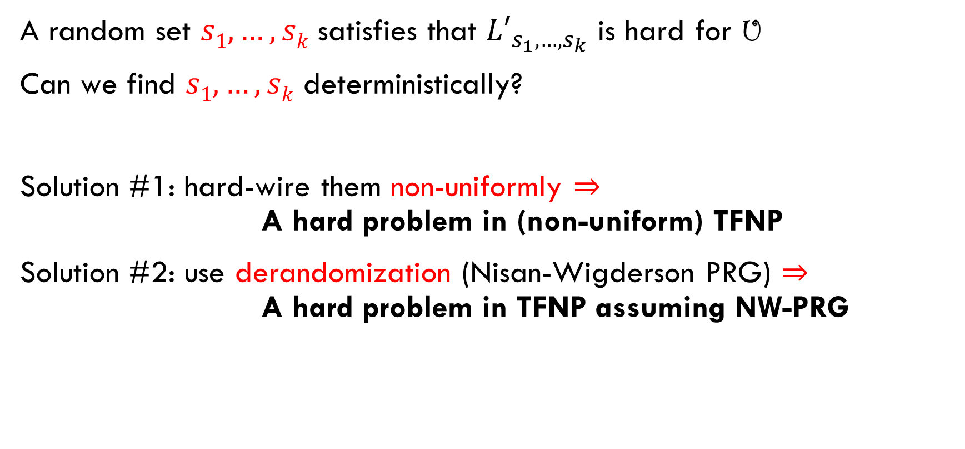
Finding a Good Shift
A random set $s1,…,sk$ satisfies that ${L′}_{s_{1},…,s_{k}}$ is hard for U
Can we find $s1,…,sk$deterministically?
Solution #1: hard-wire them non-uniformly $⇒$ A hard problem in (non-uniform) TFNP
Solution #2: use derandomization (Nisan-Wigderson PRG) $⇒$ A hard problem in TFNP assuming NW-PRG

Slide 29

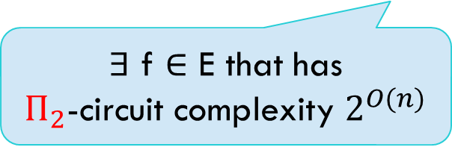
Nisan-Wigderson Pseudorandom Generator
Assume a hard function exists
∃ f $∈$ E that has $Π_{2}$-circuit complexity $2^{O(n)}$
Exists pseudorandom generator
Against $Π_{2}$-circuits
Combine all shifts to one good shift
We can derandomize

Slide 30

Hardness
Collision resistant hash / one-way permutation
[Pap94]
$$TFNP$$
$$PPP$$
$$PLS$$
P $≠$ NP ?
$$PPAD$$
Ramsey [KNY17]
?
$$CLS$$
Obfuscation/FE
[HY17]
Obfuscation/FE
[BPR15]

Slide 31
Hardness
Collision resistant hash / one-way permutation
[Pap94]
$$TFNP$$
$$PPP$$
$$PLS$$
NP is hard-on-average
$$PPAD$$
Ramsey [KNY17]
?
$$CLS$$
Obfuscation/FE
[HY17]
Obfuscation/FE
[BPR15]

Slide 32
The succinct Black-Box Model

Slide 33
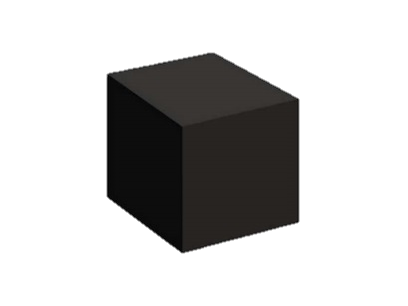


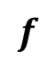
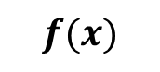

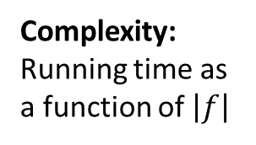

Models of Computation
The Black-Box Model
$$x$$
$$f$$
$$f(x)$$
Complexity:
# of queries
The White-Box Model
$$f$$
?
Complexity:
Running time as a function of $\left|f\right|$

Slide 34
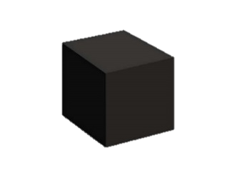

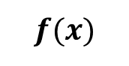


Models of Computation
The Black-Box Model
$$x$$
$$f$$
$$f(x)$$
Complexity:
# of queries
The White-Box Model
$$x$$
$$f$$
The Succinct Black-Box Model
$$f$$
$$f(x)$$
Complexity:
Running time as a function of $\left|f\right|$
Complexity:
# of queries as a function of $|f|$

Slide 35

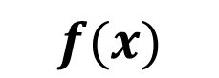

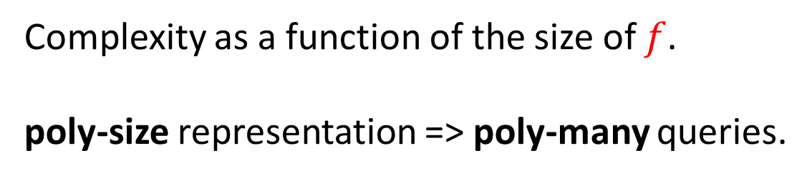
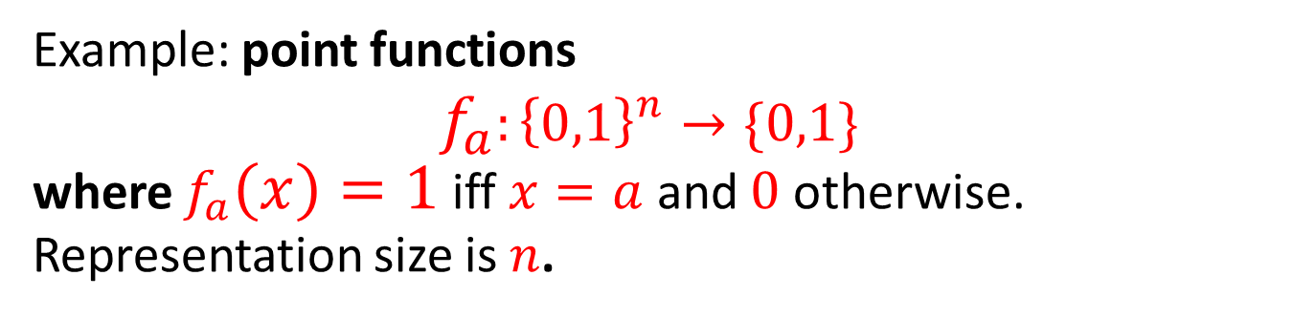

The Succinct Black-Box Model
The algorithm is given oracle (black-box) query access to the function.
Complexity as a function of the size of $f$.
poly-size representation => poly-many queries.
$$x$$
Example: point functions $$f_{a}:{\left\{0,1\right\}}^{n}→\{0,1\}$$
where $f_{a}\left(x\right)=1$ iff $x=a$ and $0$ otherwise.
Representation size is $n$.
$$f$$
$$f(x)$$
Fact: finding $a$ takes ${\sim 2}^{n }$ many queries for any algorithm.
The promise that $a$exists does not help the algorithm!

Slide 36
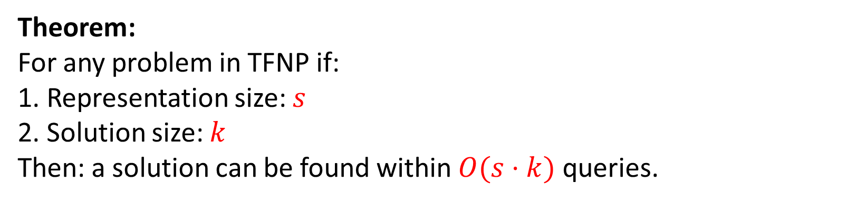

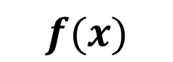

The Succinct Black-Box Model
The algorithm is given oracle (black-box) query access to the function.
Theorem: For any problem in TFNP if: 1. Representation size: $s$
2. Solution size: $k$
Then: a solution can be found within $O(s⋅k)$ queries.
$$x$$
$$f$$
$$f(x)$$
Explains why all black-box lower bounds require huge oracles
Incorrect outside TFNP
Example: point function

Slide 37
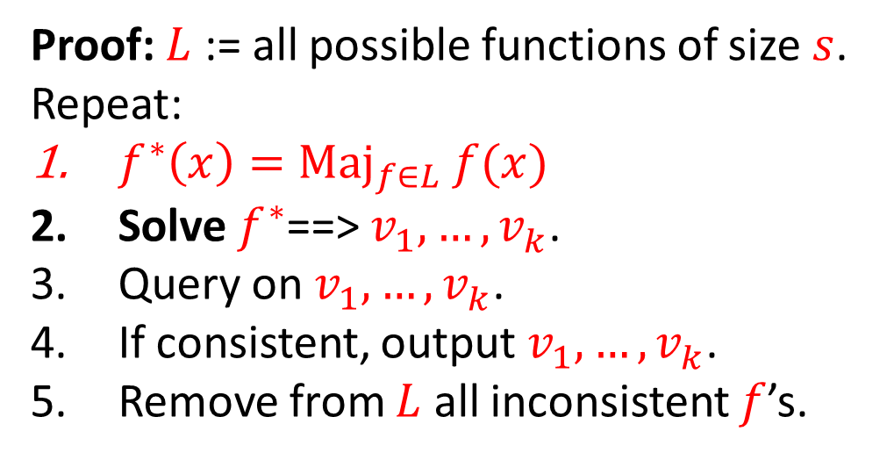
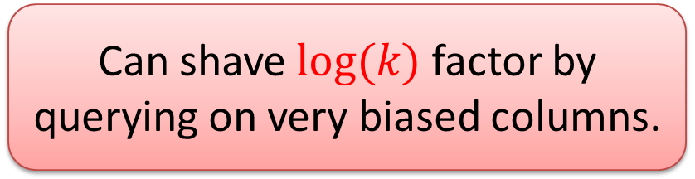
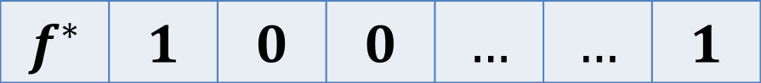
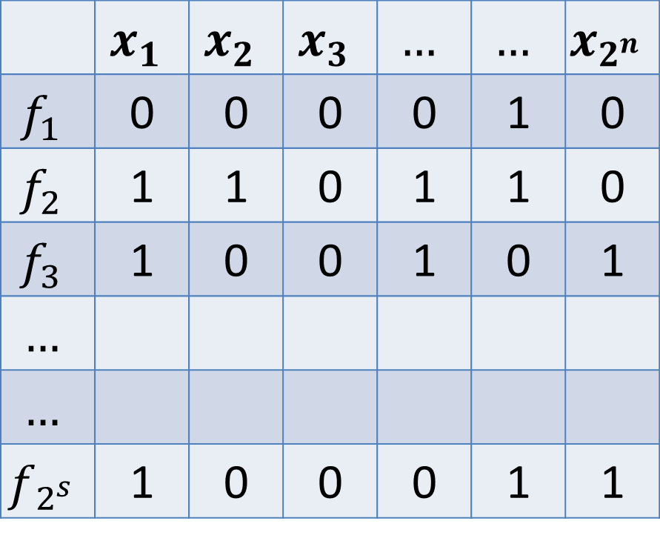

The Succinct Black-Box Model
Theorem: representation is $s$ bits, a solution is of size $k$ then a solution can be found within $O(s⋅k)$ queries.
$$x_{2^{n}}$$ | $$…$$ | $$…$$ | $$x_{3}$$ | $$x_{2}$$ | $$x_{1}$$
0 | 1 | 0 | 0 | 0 | 0 | $$f_{1}$$
0 | 1 | 1 | 0 | 1 | 1 | $$f_{2}$$
1 | 0 | 1 | 0 | 0 | 1 | $$f_{3}$$
 |  |  |  |  |  | $$…$$
 |  |  |  |  |  | $$…$$
1 | 1 | 0 | 0 | 0 | 1 | $$f_{2^{s}}$$
Proof: $L$ := all possible functions of size $s$.
Repeat:
$f^{∗}\left(x\right)={Maj}_{f∈L} f(x)$
Solve $f^{∗}$==> $v_{1}^{},…,v_{k}^{}$.
Query on $v_{1}^{},…,v_{k}^{}$.
If consistent, output $v_{1}^{},…,v_{k}^{}$.
Remove from $L$ all inconsistent $f$’s.
Main point: At every iteration we either find a solution or remove half of the rows.
Can shave $log(k)$ factor by querying on very biased columns.
$$1$$ | $$…$$ | $$…$$ | $$0$$ | $$0$$ | $$1$$ | $$f^{∗}$$

Slide 38

Collision resistant hash / one-way permutation
$$TFNP$$
$$PPP$$
$$PLS$$
NP is hard-on-average
$$PPAD$$
Ramsey
?
$$CLS$$
Obfuscation/FE
Obfuscation/FE

